Slide 1

Cassandra Training

Slide 2
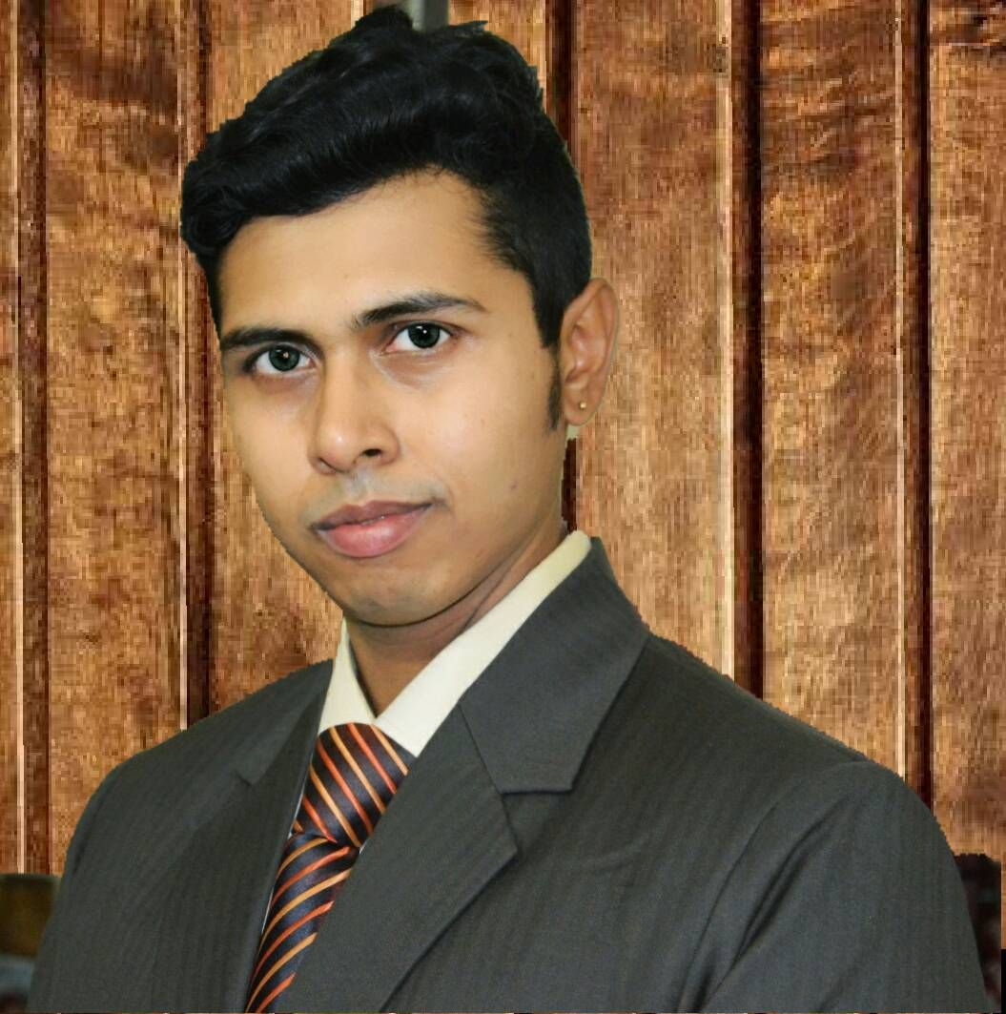

Introduction
Ritam Mukherjee
- Software Enthusiastic
- Passionate About Coding
- Love to mentor people
https://www.linkedin.com/in/ritam-mukherjee-9b7b3850/

Slide 3
Course Curriculum
Introduction
Introduction
Introduction
Topic
Topic
Topic
Topic
Topic

Slide 4
Today’s Agenda
Cassandra building Blocks

Slide 6
Thank YOU..!!
**We appreciate your feedback and this will help us improve in delivering qualitative trainings further.

